Slide 1

IWPA Response to CERC Draft Order 9/SM/2025
Determination of value of “X” for computation of the deviation (in %) for Wind and Solar (WS) Sellers from 01.04.2026 onwards under the provisions of the Central Electricity Regulatory Commission (Deviation Settlement Mechanism and Related Matters) Regulations, 2024
Public Hearing -03rd Dec 2025

Slide 2
KEY CONCERNS on DSM…
SECTION 1 - THE PROPOSED CHANGE IN DSM Regulation
SECTION 2 - THE CORE CHALLENGES
SECTION 3 - BROADER IMPLICATIONS
SECTION 4 - WAY FORWARD

Slide 3
Concerns on Deviation Settlement Mechanism for Wind Energy
Legal Status & Context
IWPA has challenged the 2024 DSM Regulations before Delhi High Court (WP(C) No. 5487/2025)
Court issued 'no coercive action' order dated 29.04.2025 - still in operation
Draft proposal should be kept in abeyance until final adjudication
The Problem in 60 Seconds
Proposed 'X-Factor' mechanism shifts deviation calculation from Available Capacity to Scheduled Generation
X factor reduces from 100% to 0% by 2031 (20% reduction per year)
Wind revenue losses: Up to 48.2% under X=0 scenario (Grid-India study)
73% of wind energy would attract penalties (vs 14% currently)
Projects will become NPAs - threatening India's 500 GW renewable target

Slide 4
SECTION 1
THE PROPOSED CHANGE IN DSM REGULATIONS

Slide 5
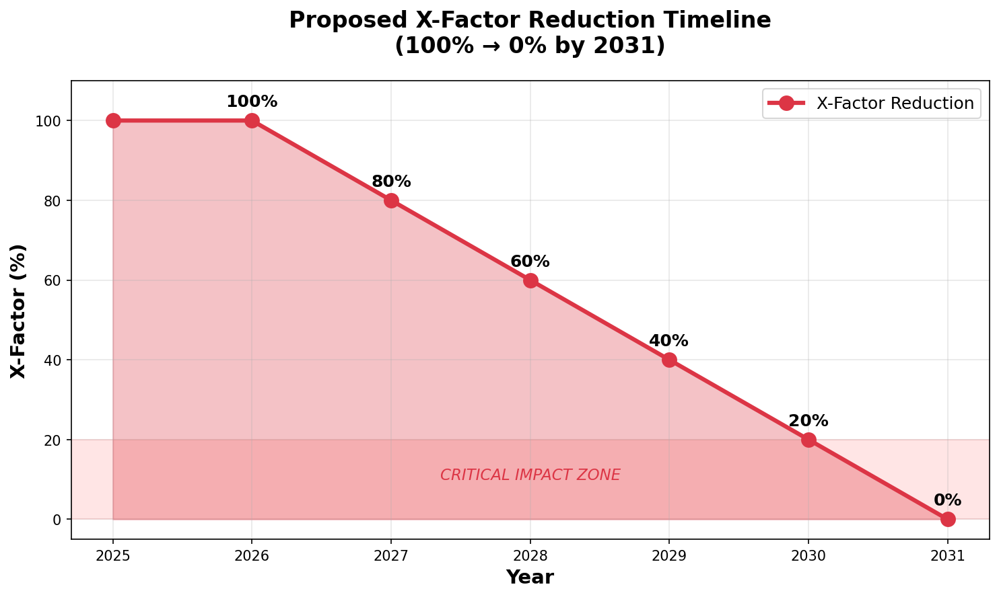
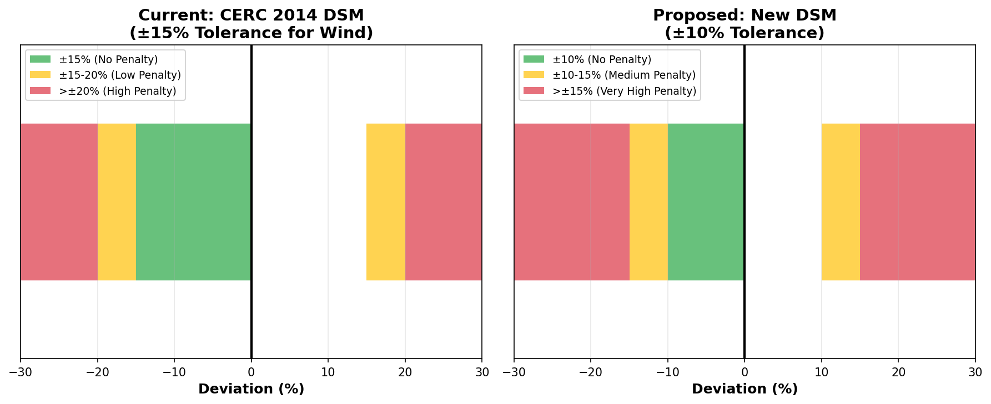
The X-Factor Mechanism
THE PROPOSED CHANGE
Tightening Deviation Bands
Penalty severity increases while forecasting infrastructure lags behind
Wind tolerance narrows from ±15% to ±10%
No pay>110%

Slide 6
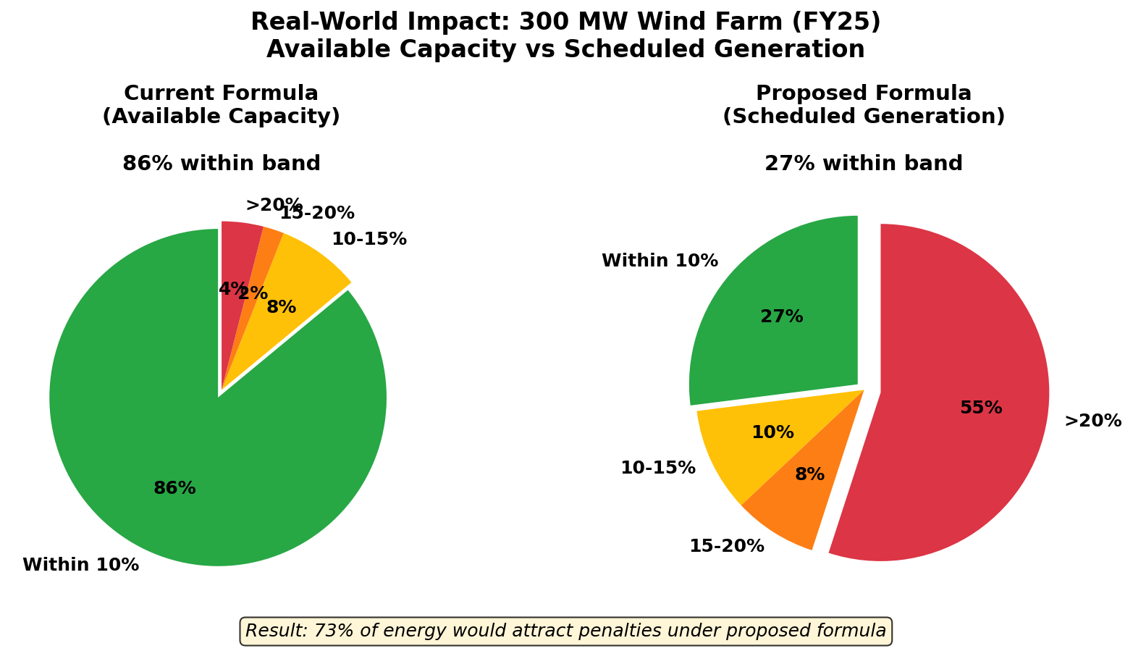
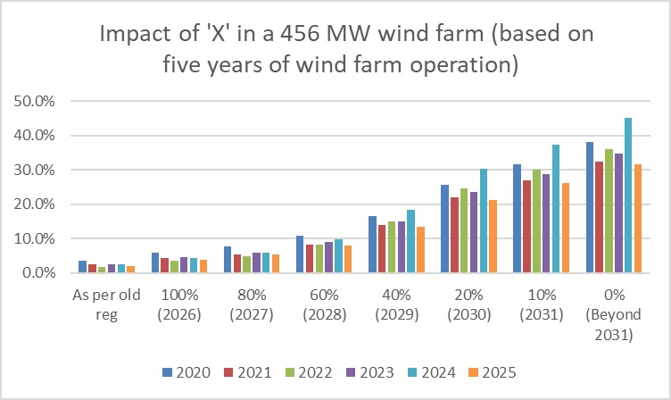
300 MW Wind Farm – Bands
Real World Impact – Bands / Revenues
Changing the formula dramatically increases penalties
Revenue Losses ~ 450MW of Wind farm
Based on 5 year’s data

Slide 7
SECTION 2
THE CORE CHALLENGES

Slide 8
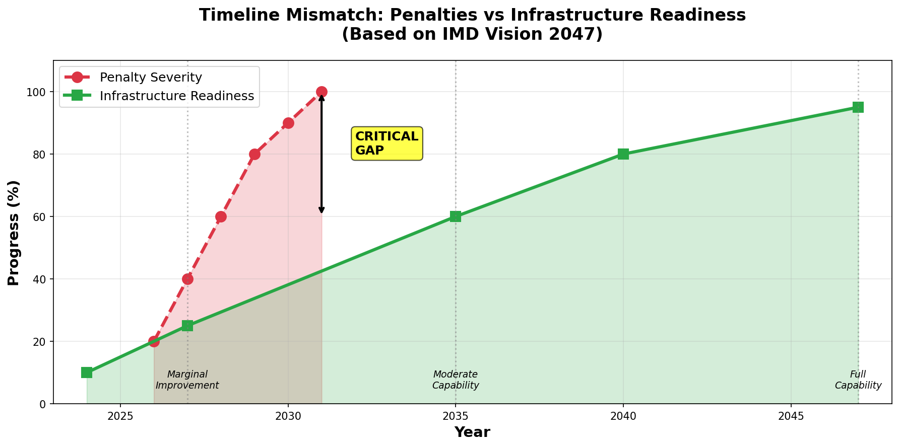
The Core Challenges
1. Forecasting Limitations
2. Critical Timeline Mismatch
Weather Forecasting is the basic precursor for wind power forecasting.
  Good weather forecast requires meteorological data collection at a completely different level
  This is completely unavailable in large areas in India
  This is serious limitation over which industry has no control
IMD Vision-2047 Report admits 'considerable challenges in forecasting models'
CEA (Sept 2024): Insufficient meteorological data from wind/solar farming areas
WRF models operate on coarse scales (30 km spatial, 6-hour temporal resolution) with input data that is grossly inadequate.
Wind power curve is non-linear - small wind eed errors cause large power deviations
Short-term predictability for isolated, small-scale storms remains difficult as per IMD vision document
Penalties ramp up while infrastructure won't be ready until 2035-2047

Slide 9
The Core Challenges:
3. Infrastructure Gaps Acknowledged by Authorities
4. Aggregation: Limited Benefits
Current observational density: Large areas left out of meteorological measurements.
Coverage network is part of a larger program and is underway as per IMD’s plan
Village-level coverage not expected until 2047
Model resolution: Currently 12 km, needs to reach sub-km for accuracy
CEA formed committee with Ministry of Earth Sciences to improve weather data collection
REMCs and NLDCs themselves struggle to meet DSM forecasting accuracy
Grid-India’s own study shows only marginal improvement with aggregation (~20% reduction in DSM)
Under ±10% band: compliance remains 32%-73% of time blocks even with aggregation
High wind season barely touches 54% compliance
Additional costs: Administrative burden, data-sharing challenges, high QCA fees
Does not solve fundamental forecasting limitations - only masks the problem partially

Slide 10
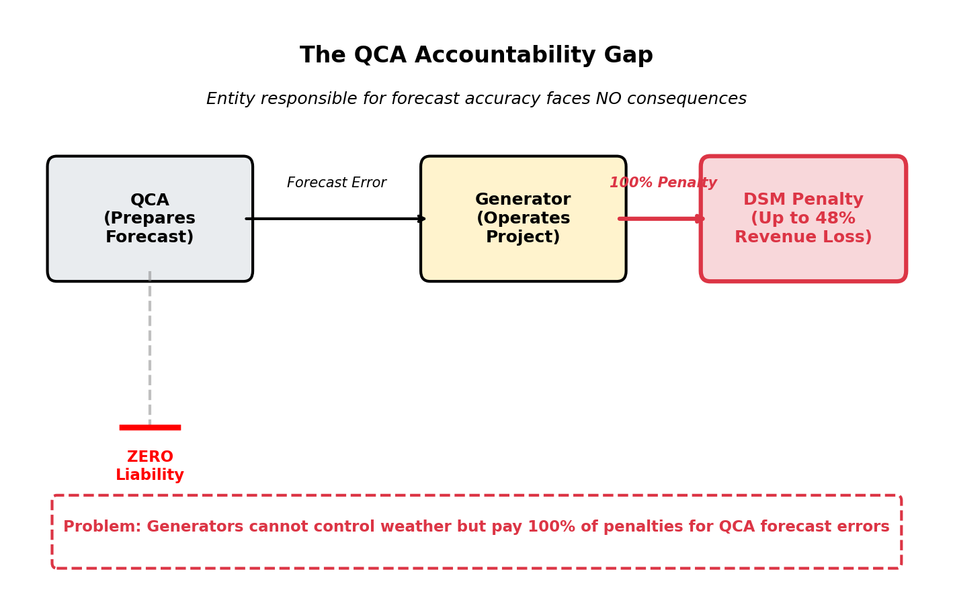
The Core Challenges: Accountability Gap
5. QCA – Responsible for forecast but not accountable
6. No Evidence of Grid Security Concerns
Zero documented cases of grid instability specifically caused by wind/solar deviations
No frequency violation data attributable to RE variability
No comparison with deviations from conventional generators (which also deviate)
Grid-India study only analyzed revenue impact - NO modeling of grid security scenarios
No demonstration that tighter DSM would have prevented any real-world grid incident

Slide 11
The Core Challenges: The Fundamental Fairness Issue
Wind generators CANNOT control weather (unlike conventional generators controlling fuel)
Treating weather-dependent and fuel-dependent generators equally is fundamentally unfair
Conventional plants regulate fuel supply, ramp rates, and output at will
Wind generators must accept whatever nature provides
Penalties should reflect controllability - not just deviations
Mere penalizing generators will not result in anticipated improvements
However, it will certainly result in turning all wind projects in to NPAs

Slide 12
SECTION 3
BROADER IMPLICATIONS

Slide 13
Broader Implications
Constitutional Concerns
Policy Misalignment with National Goals
Article 14 (Equality): Wind generators cannot be equated with conventional generators - equal treatment of unequals
Disproportionate disadvantage to wind vs fossil fuel generators violates equal protection
Article 19(1)(g) (Right to Practice Profession): Up to 48.2% revenue loss threatens project viability and right to conduct business
Supreme Court (Shiv Shakti Sugars): Must balance economic interests with constitutional rights
Arbitrary 20% YoY X-factor reduction lacks rational nexus to forecasting capability improvement
Electricity Act objective: 'Promote generation from renewable sources of energy'
APTEL: Preferential treatment for RE is declared State policy
National commitment: 500 GW renewable energy capacity by 2030
Climate commitments under Paris Agreement require RE promotion
Proposed DSM undermines investment climate - future projects at risk

Slide 14
Broader Implications
International Best Practices
Europe: Advanced granular forecasting systems developed WITH meteorological services (not penalties). They carry out their own forecasting.
Deviations settled through normal balancing markets, not punitive charges exceeding 200% of tariff
System operators share balancing responsibilities - costs distributed fairly
Investment in better forecasting tools and ancillary services BEFORE tightening penalties
India should adopt infrastructure-first approach rather than penalty-first approach

Slide 15
SECTION 4
WAY FORWARD

Slide 16
Way Forward …..
IWPA Key Recommendations
Proposed Roadmap
DEFER implementation of 'X' mechanism until forecasting infrastructure demonstrably improves (post-2035)
CONTINUE with CERC 2014 DSM framework (±15% tolerance for wind, Available Capacity formula)
ESTABLISH QCA accountability with performance bonds, penalties for poor forecasting, and benchmark standards
PRIORITIZE building capacity: Dense weather sensor networks, REMC tools, enable aggregation mechanisms
CONDUCT multi-year data analysis (minimum 3-5 years covering all seasons) before tightening any bands
Phase 1 (2025-2027): Infrastructure development - weather stations, data networks, REMC capacity building
Phase 2 (2027-2030): Pilot testing with voluntary aggregation, QCA performance benchmarking
Phase 3 (2030-2035): Gradual band tightening ONLY IF forecasting accuracy demonstrably improves
Phase 4 (Post-2035): Consider X-factor reduction based on actual achieved forecasting capabilities
Continuous monitoring: Regular reviews with industry, IMD, and CERC collaboration

Slide 17
Way Forward …..
Support RE Growth, Don't Punish Variability
Infrastructure BEFORE penalties - align with global best practices
Forecasting capability must improve BEFORE tightening deviation bands
QCA accountability essential for fair framework
Balance grid stability needs with renewable sector viability
IWPA committed to working with CERC on forecasting improvements within a fair framework
Request: Maintain CERC 2014 DSM framework until forecasting infrastructure is validated

Slide 18

THANK YOU
IWPA

